Slide 1
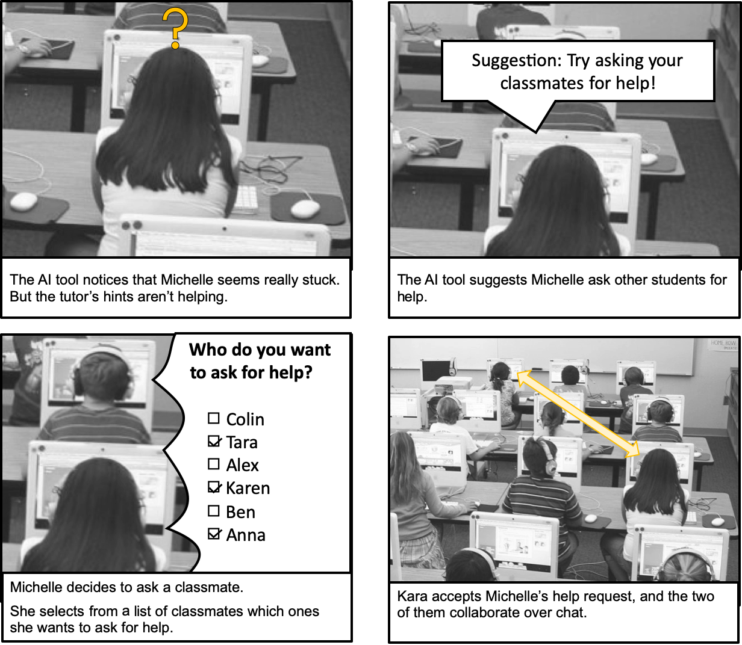
Case 1: Students controlling the pairing
Is it ok to let the student have complete control/agency over the pairing?
If so, is there anything you would want to know about what students are doing, regarding pairing?
What kind of information?
When would you want to know?
Would you want to have some control over how students are paired too?
If so: What kind of control?
Would you want to have all the control over pairing?

Slide 2
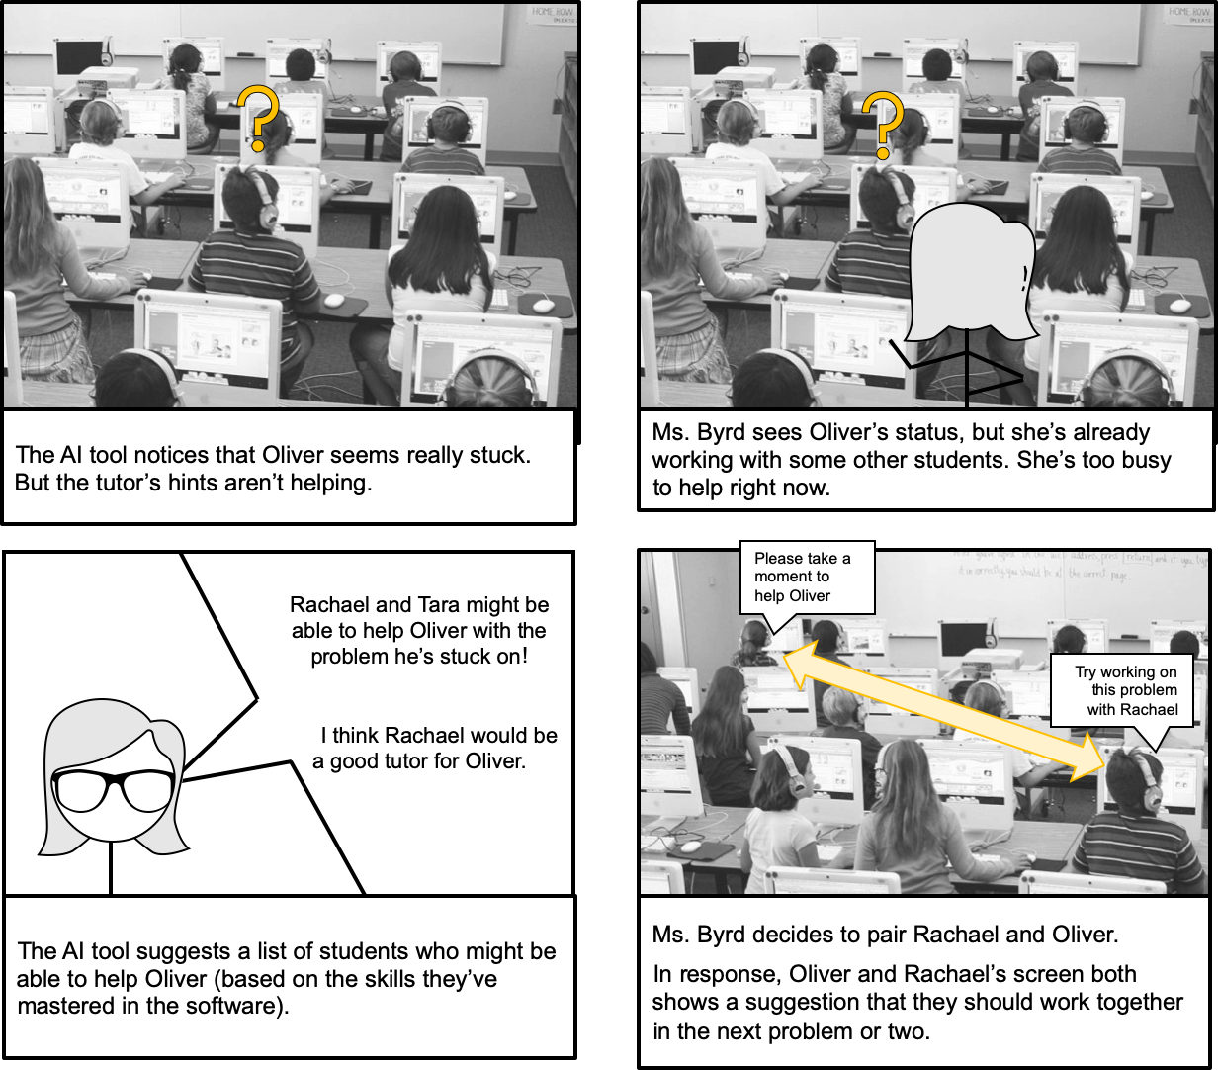
Case 2: Teachers controlling the pairing
How was your experience of being able to control with students get paired?
If the teacher brings up that it was burdensome:
Would you suggest any other strategies to avoid this?
Would it be better if you have to accept/reject the paring?
[coming from students] [coming from the AI tool]
If the teacher responds positively:
Is there anything you would change?
Did you feel the burden of controlling/initializing the pairing?

Slide 3
Case 2: Teachers controlling the pairing
How was your experience of being able to control when students get paired?
If the teacher brings up that it was burdensome:
Would you suggest any other strategies to avoid this?
Would it be better if you have to accept/reject the paring?
[coming from students] [coming from the system]
If the teacher responds positively:
Is there anything you would change?
Would it be better if you have to accept/reject the paring?
[coming from students] [coming from the system]

Slide 4
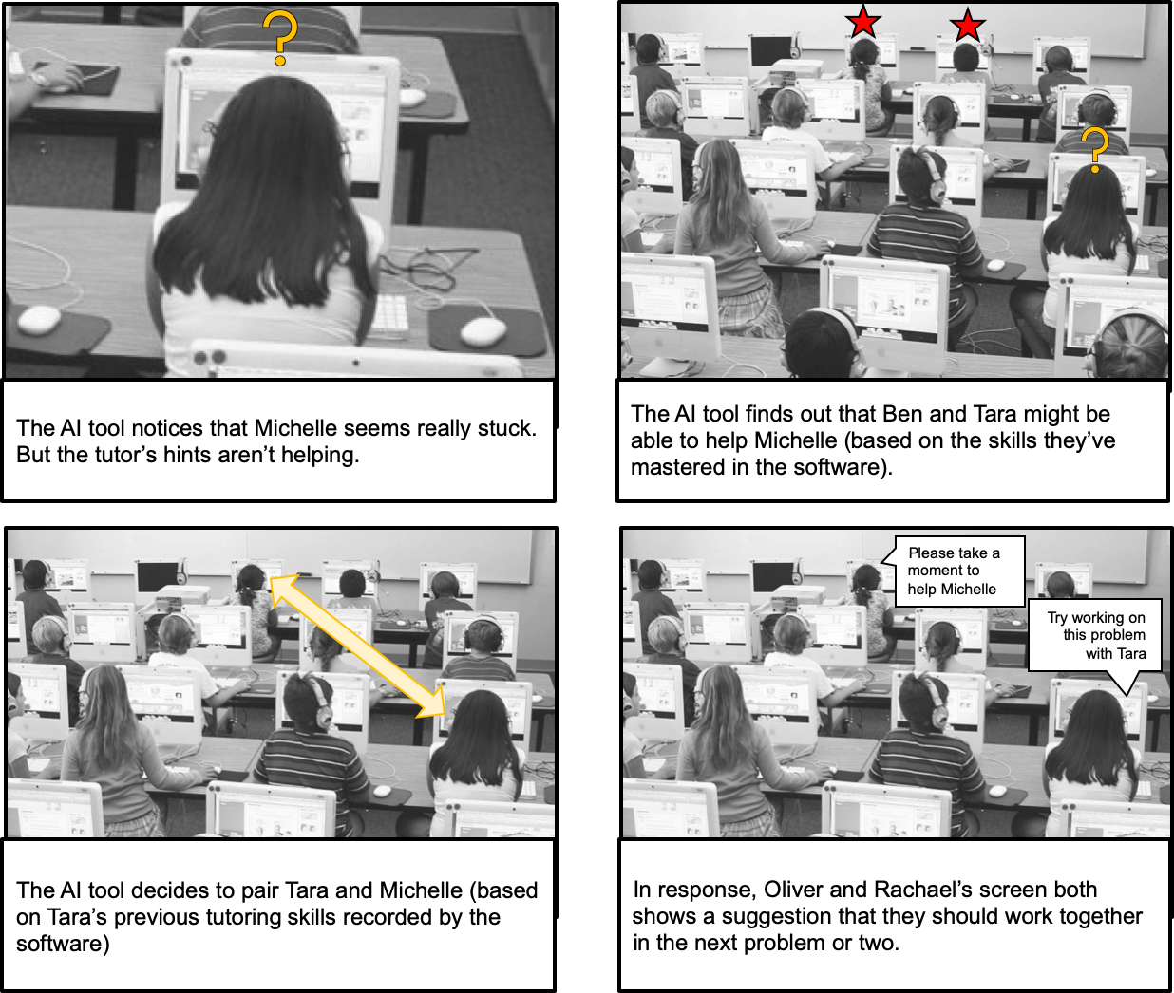
Case 3: AI tool controlling the pairing
Things to explore:
Is it ok to let the AI tool have complete control/agency of the pairing?
If so, is there anything you would want to know about what students are doing, regarding pairing?
What kind of information?
When would you want to know?
Would you want to have some control over how students are paired too?
If so: What kind of control?
Would you want to have all the control over pairing?
If so, when would you have wanted information about the pairing?
Or, would you be more inclined to have to control of the pairing? (accept/reject the pairing)

Slide 5
Case 3: AI tool controlling the pairing
Things to explore:
Is it ok to let the AI tool have complete control/agency of the pairing?
If so, is there anything you would want to know about what students are doing, regarding pairing?
What kind of information?
When would you want to know?
Would you want to have some control over how students are paired too?
If so: What kind of control?
Would you want to have all the control over pairing?

Slide 6
After exploring the three cases...
Which one would you prefer? (order of preference - voting)
Why you prefer this option vs others?
Explore hybrid cases
Notes:
After this, we move into the exploration of how monitoring individual/collaboration activities...

Slide 7
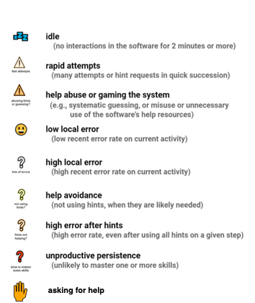
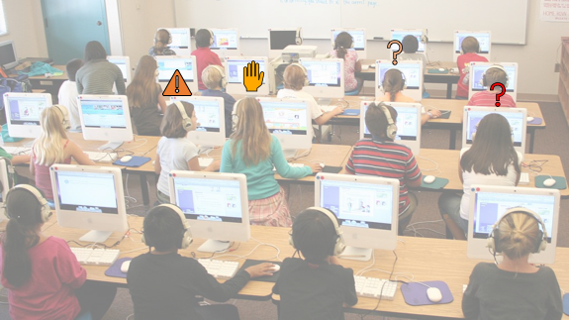
Students are being monitored by Lumilo
Notes:
Brief explanation to Lumilo
(Except for the teacher who hasn’t experienced Lumilo)

Slide 8

What kind of information would you like to see:
During pairing?
When working collaboratively and individually?
How would you detect an unproductive collaboration activity?
How would you visualize this?
Some students got paired and are working in a peer tutoring activity, and some others are working individually

